Slide 1

E6893 Big Data Analytics:
Yahoo Finance Stock Analytics
Group 9
Team Members:
Pingyuan Wang
Xuanyu Chen
November 17, 2016
1

Slide 2


Business Value
Stock reviewing websites are surrounded by masses of unstructured data.(social media, blogs,etc)
Big data analysis is increasingly being used to provide deep insight and predictive analysis into stock market movements and individual investment behaviors, Those that are able to make use and harness the power of this disruptive force in markets will benefit by being smarter, faster and more efficient.

Slide 3
Implementation and Algorithm

Slide 4
Data
Algorithm
Software Used
Yahoo Finance
Classification Method in Yahoo Finance
Naive Bayes
Logistic Regression
Random Forest
Support Vector Machine
R
Python
Spark

Slide 5
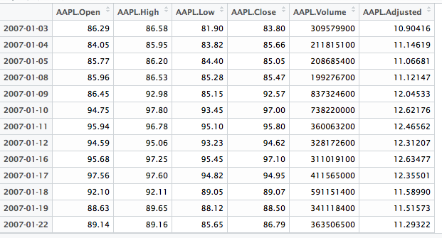

Dataset Structure
From Yahoo Finance

Slide 6
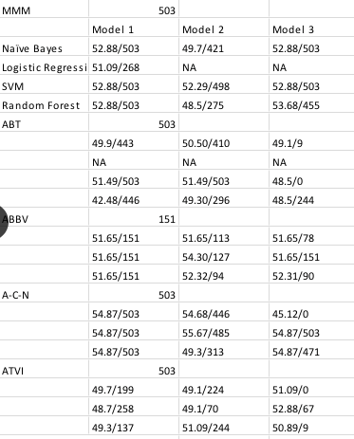
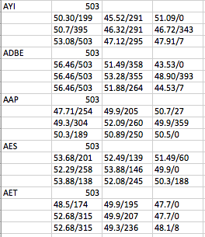
Test Data
Challenges
Fnding

Slide 7

Process
1.Download 10 years S&P 500 stock data form Yahoo Finance
2. Data cleaning in Jupyter Notebook.
3. Convert data libsvm format in Python
4. Run SVM in Scala, 80% training and 20% test
5, Use sparklyr and SparkR to run Naive Bayes in RStudio

Slide 8
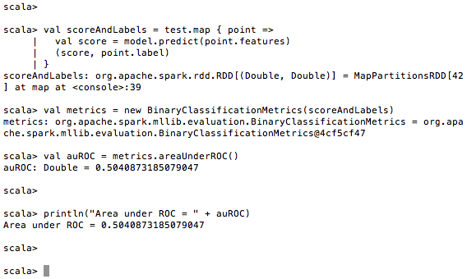
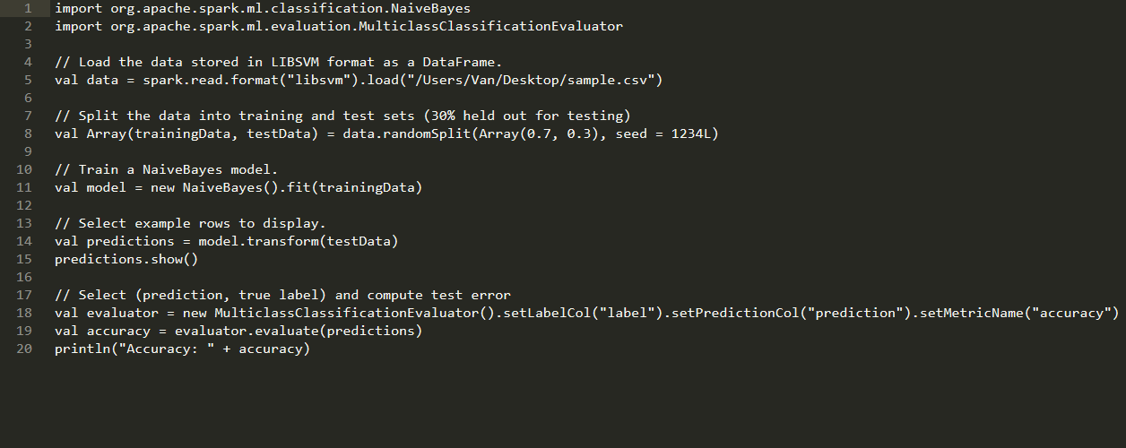
Conclusion

Slide 9

Future Work
As we encounter lots of problems when we try to do sentiment analysis on Stocktwits data, we would mainly focus on solving those problems as future work.

Slide 10


